Slide 1
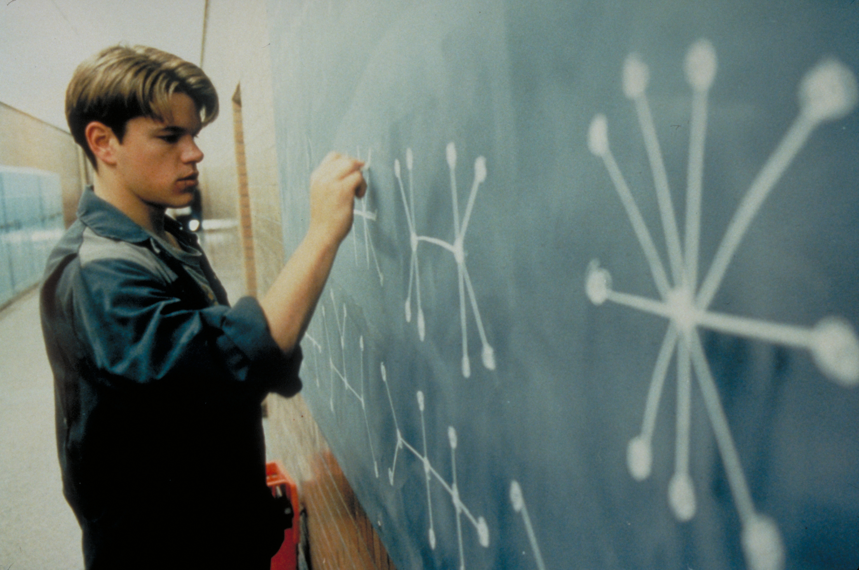
Spanning Trees
Megan Faulk
CS 106B
Lecture 22
Mar 4, 2016
CS 106B
2011

Slide 2

Today’s Goal
Learn what a Spanning Tree is
Understand Kruskal’s Algorithm

Slide 3


Today’s Route
Monday
WOW!
Kruskal
MST
Spanning Tree

Slide 4
Spanning trees
A spanning tree of a graph is a set of edges that connects all vertices in the graph with no cycles.
What is a spanning tree for the graph below?
V
V
a
b
b
U
d
X
Z
U
X
Z
h
h
c
e
c
e
W
g
W
g
f
Y
Y

Slide 5

Span tree examples
Q: How many of the graphs shown are legal spanning trees?
A. none
B. one
C. two
D. all three
(1)
(2)
(3)

Slide 6
Today’s Route
Monday
WOW!
Kruskal
MST
Spanning Tree

Slide 7
Today’s Route
Monday
WOW!
Kruskal
MST
Spanning Tree

Slide 8
Minimum spanning tree
minimum spanning tree (MST): A spanning tree that has the lowest combined edge weight (cost), or minimum # edges if unweighted.
V
V
a
b
b
U
d
X
Z
U
X
Z
h
h
c
e
c
e
W
g
W
g
f
Y
Y

Slide 9
MST examples
Q: How many minimum spanning trees does this graph have?
A. 0-1
B. 2-3
C. 4-5
D. 6-7
E. > 7
(question courtesy Cynthia Lee)
B
D
F
1
7
3
3
A
C
E
3
3

Slide 10
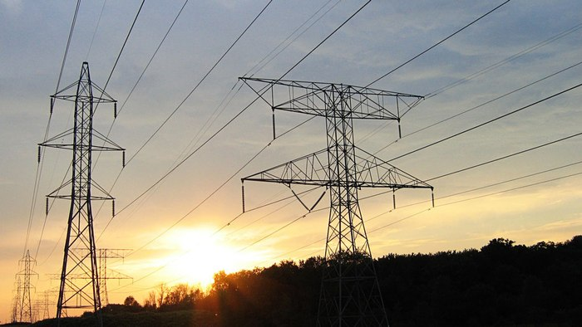
Network Design

Slide 11
Today’s Route
Monday
WOW!
Kruskal
MST
Spanning Tree

Slide 12
Today’s Route
Monday
WOW!
Kruskal
MST
Spanning Tree

Slide 13
Kruskal's algorithm
Kruskal's algorithm: Finds a MST in a given graph.
function kruskal(graph):
Remove all edges from the graph.
Place all edges into a priority queue based on their weight (cost).
While the priority queue is not empty:
Dequeue an edge e from the priority queue.
If e's endpoints aren't already connected to one another, add that edge into the graph.
Otherwise, skip the edge.

Slide 14
Kruskal example
In what order would Kruskal's algorithm visit the edges in the graph below? What MST would it produce?
function kruskal(graph):
Remove all edges from the graph.
Place all edges into a priority queue based on their weight (cost).
While the priority queue is not empty:
Dequeue an edge e from the priority queue.
If e's endpoints aren't already connected, add that edge into the graph.
Otherwise, skip the edge.
pq = {a:1, b:2, c:3, d:4, e:5, f:6, g:7, h:8, i:9, j:10, k:11, l:12, m:13, n:14, o:15, p:16, q:17, r:18}
q:17
p:16
k:11
i:9
m:13
j:10
o:15
f:6
r:18
a:1
c:3
g:7
b:2
e:5
n:14
d:4
l:12
h:8

Slide 15
Kruskal example
In what order would Kruskal's algorithm visit the edges in the graph below? What MST would it produce?
function kruskal(graph):
Remove all edges from the graph.
Place all edges into a priority queue based on their weight (cost).
While the priority queue is not empty:
Dequeue an edge e from the priority queue.
If e's endpoints aren't already connected, add that edge into the graph.
Otherwise, skip the edge.
pq = {a:1, b:2, c:3, d:4, e:5, f:6, g:7, h:8, i:9, j:10, k:11, l:12, m:13, n:14, o:15, p:16, q:17, r:18}
q:17
p:16
k:11
i:9
m:13
j:10
o:15
f:6
r:18
a:1
c:3
g:7
b:2
e:5
n:14
d:4
l:12
h:8

Slide 16
Kruskal example
In what order would Kruskal's algorithm visit the edges in the graph below? What MST would it produce?
function kruskal(graph):
Remove all edges from the graph.
Place all edges into a priority queue based on their weight (cost).
While the priority queue is not empty:
Dequeue an edge e from the priority queue.
If e's endpoints aren't already connected, add that edge into the graph.
Otherwise, skip the edge.
pq = {b:2, c:3, d:4, e:5, f:6, g:7, h:8, i:9, j:10, k:11, l:12, m:13, n:14, o:15, p:16, q:17, r:18}
q:17
p:16
k:11
i:9
m:13
j:10
o:15
f:6
r:18
a:1
c:3
g:7
b:2
e:5
n:14
d:4
l:12
h:8

Slide 17
Kruskal example
In what order would Kruskal's algorithm visit the edges in the graph below? What MST would it produce?
function kruskal(graph):
Remove all edges from the graph.
Place all edges into a priority queue based on their weight (cost).
While the priority queue is not empty:
Dequeue an edge e from the priority queue.
If e's endpoints aren't already connected, add that edge into the graph.
Otherwise, skip the edge.
pq = {c:3, d:4, e:5, f:6, g:7, h:8, i:9, j:10, k:11, l:12, m:13, n:14, o:15, p:16, q:17, r:18}
q:17
p:16
k:11
i:9
m:13
j:10
o:15
f:6
r:18
a:1
c:3
g:7
b:2
e:5
n:14
d:4
l:12
h:8

Slide 18
Kruskal example
In what order would Kruskal's algorithm visit the edges in the graph below? What MST would it produce?
function kruskal(graph):
Remove all edges from the graph.
Place all edges into a priority queue based on their weight (cost).
While the priority queue is not empty:
Dequeue an edge e from the priority queue.
If e's endpoints aren't already connected, add that edge into the graph.
Otherwise, skip the edge.
pq = {d:4, e:5, f:6, g:7, h:8, i:9, j:10, k:11, l:12, m:13, n:14, o:15, p:16, q:17, r:18}
q:17
p:16
k:11
i:9
m:13
j:10
o:15
f:6
r:18
a:1
c:3
g:7
b:2
e:5
n:14
d:4
l:12
h:8

Slide 19
Kruskal example
In what order would Kruskal's algorithm visit the edges in the graph below? What MST would it produce?
function kruskal(graph):
Remove all edges from the graph.
Place all edges into a priority queue based on their weight (cost).
While the priority queue is not empty:
Dequeue an edge e from the priority queue.
If e's endpoints aren't already connected, add that edge into the graph.
Otherwise, skip the edge.
pq = {e:5, f:6, g:7, h:8, i:9, j:10, k:11, l:12, m:13, n:14, o:15, p:16, q:17, r:18}
q:17
p:16
k:11
i:9
m:13
j:10
o:15
f:6
r:18
a:1
c:3
g:7
b:2
e:5
n:14
d:4
l:12
h:8

Slide 20
Kruskal example
In what order would Kruskal's algorithm visit the edges in the graph below? What MST would it produce?
function kruskal(graph):
Remove all edges from the graph.
Place all edges into a priority queue based on their weight (cost).
While the priority queue is not empty:
Dequeue an edge e from the priority queue.
If e's endpoints aren't already connected, add that edge into the graph.
Otherwise, skip the edge.
pq = {f:6, g:7, h:8, i:9, j:10, k:11, l:12, m:13, n:14, o:15, p:16, q:17, r:18}
q:17
p:16
k:11
i:9
m:13
j:10
o:15
f:6
r:18
a:1
c:3
g:7
b:2
e:5
n:14
d:4
l:12
h:8

Slide 21
Kruskal example
In what order would Kruskal's algorithm visit the edges in the graph below? What MST would it produce?
function kruskal(graph):
Remove all edges from the graph.
Place all edges into a priority queue based on their weight (cost).
While the priority queue is not empty:
Dequeue an edge e from the priority queue.
If e's endpoints aren't already connected, add that edge into the graph.
Otherwise, skip the edge.
pq = {g:7, h:8, i:9, j:10, k:11, l:12, m:13, n:14, o:15, p:16, q:17, r:18}
q:17
p:16
k:11
i:9
m:13
j:10
o:15
f:6
r:18
a:1
c:3
g:7
b:2
e:5
n:14
d:4
l:12
h:8

Slide 22
Kruskal example
In what order would Kruskal's algorithm visit the edges in the graph below? What MST would it produce?
function kruskal(graph):
Remove all edges from the graph.
Place all edges into a priority queue based on their weight (cost).
While the priority queue is not empty:
Dequeue an edge e from the priority queue.
If e's endpoints aren't already connected, add that edge into the graph.
Otherwise, skip the edge.
pq = {h:8, i:9, j:10, k:11, l:12, m:13, n:14, o:15, p:16, q:17, r:18}
q:17
p:16
k:11
i:9
m:13
j:10
o:15
f:6
r:18
a:1
c:3
g:7
b:2
e:5
n:14
d:4
l:12
h:8

Slide 23
Kruskal example
In what order would Kruskal's algorithm visit the edges in the graph below? What MST would it produce?
function kruskal(graph):
Remove all edges from the graph.
Place all edges into a priority queue based on their weight (cost).
While the priority queue is not empty:
Dequeue an edge e from the priority queue.
If e's endpoints aren't already connected, add that edge into the graph.
Otherwise, skip the edge.
pq = {i:9, j:10, k:11, l:12, m:13, n:14, o:15, p:16, q:17, r:18}
q:17
p:16
k:11
i:9
m:13
j:10
o:15
f:6
r:18
a:1
c:3
g:7
b:2
e:5
n:14
d:4
l:12
h:8

Slide 24
Kruskal example
In what order would Kruskal's algorithm visit the edges in the graph below? What MST would it produce?
function kruskal(graph):
Remove all edges from the graph.
Place all edges into a priority queue based on their weight (cost).
While the priority queue is not empty:
Dequeue an edge e from the priority queue.
If e's endpoints aren't already connected, add that edge into the graph.
Otherwise, skip the edge.
pq = {j:10, k:11, l:12, m:13, n:14, o:15, p:16, q:17, r:18}
q:17
p:16
k:11
i:9
m:13
j:10
o:15
f:6
r:18
a:1
c:3
g:7
b:2
e:5
n:14
d:4
l:12
h:8

Slide 25
Kruskal example
In what order would Kruskal's algorithm visit the edges in the graph below? What MST would it produce?
function kruskal(graph):
Remove all edges from the graph.
Place all edges into a priority queue based on their weight (cost).
While the priority queue is not empty:
Dequeue an edge e from the priority queue.
If e's endpoints aren't already connected, add that edge into the graph.
Otherwise, skip the edge.
pq = {k:11, l:12, m:13, n:14, o:15, p:16, q:17, r:18}
q:17
p:16
k:11
i:9
m:13
j:10
o:15
f:6
r:18
a:1
c:3
g:7
b:2
e:5
n:14
d:4
l:12
h:8

Slide 26
Kruskal example
In what order would Kruskal's algorithm visit the edges in the graph below? What MST would it produce?
function kruskal(graph):
Remove all edges from the graph.
Place all edges into a priority queue based on their weight (cost).
While the priority queue is not empty:
Dequeue an edge e from the priority queue.
If e's endpoints aren't already connected, add that edge into the graph.
Otherwise, skip the edge.
pq = {l:12, m:13, n:14, o:15, p:16, q:17, r:18}
q:17
p:16
k:11
i:9
m:13
j:10
o:15
f:6
r:18
a:1
c:3
g:7
b:2
e:5
n:14
d:4
l:12
h:8

Slide 27
Kruskal example
In what order would Kruskal's algorithm visit the edges in the graph below? What MST would it produce?
function kruskal(graph):
Remove all edges from the graph.
Place all edges into a priority queue based on their weight (cost).
While the priority queue is not empty:
Dequeue an edge e from the priority queue.
If e's endpoints aren't already connected, add that edge into the graph.
Otherwise, skip the edge.
pq = {m:13, n:14, o:15, p:16, q:17, r:18}
q:17
p:16
k:11
i:9
m:13
j:10
o:15
f:6
r:18
a:1
c:3
g:7
b:2
e:5
n:14
d:4
l:12
h:8

Slide 28
Kruskal example
In what order would Kruskal's algorithm visit the edges in the graph below? What MST would it produce?
function kruskal(graph):
Remove all edges from the graph.
Place all edges into a priority queue based on their weight (cost).
While the priority queue is not empty:
Dequeue an edge e from the priority queue.
If e's endpoints aren't already connected, add that edge into the graph.
Otherwise, skip the edge.
pq = {n:14, o:15, p:16, q:17, r:18}
q:17
p:16
k:11
i:9
m:13
j:10
o:15
f:6
r:18
a:1
c:3
g:7
b:2
e:5
n:14
d:4
l:12
h:8

Slide 29
Kruskal example
In what order would Kruskal's algorithm visit the edges in the graph below? What MST would it produce?
function kruskal(graph):
Remove all edges from the graph.
Place all edges into a priority queue based on their weight (cost).
While the priority queue is not empty:
Dequeue an edge e from the priority queue.
If e's endpoints aren't already connected, add that edge into the graph.
Otherwise, skip the edge.
pq = {o:15, p:16, q:17, r:18}
q:17
p:16
k:11
i:9
m:13
j:10
o:15
f:6
r:18
a:1
c:3
g:7
b:2
e:5
n:14
d:4
l:12
h:8

Slide 30
Kruskal example
In what order would Kruskal's algorithm visit the edges in the graph below? What MST would it produce?
function kruskal(graph):
Remove all edges from the graph.
Place all edges into a priority queue based on their weight (cost).
While the priority queue is not empty:
Dequeue an edge e from the priority queue.
If e's endpoints aren't already connected, add that edge into the graph.
Otherwise, skip the edge.
pq = {p:16, q:17, r:18}
q:17
p:16
k:11
i:9
m:13
j:10
o:15
f:6
r:18
a:1
c:3
g:7
b:2
e:5
n:14
d:4
l:12
h:8

Slide 31
Kruskal example
In what order would Kruskal's algorithm visit the edges in the graph below? What MST would it produce?
function kruskal(graph):
Remove all edges from the graph.
Place all edges into a priority queue based on their weight (cost).
While the priority queue is not empty:
Dequeue an edge e from the priority queue.
If e's endpoints aren't already connected, add that edge into the graph.
Otherwise, skip the edge.
pq = {q:17, r:18}
q:17
p:16
k:11
i:9
m:13
j:10
o:15
f:6
r:18
a:1
c:3
g:7
b:2
e:5
n:14
d:4
l:12
h:8

Slide 32
Kruskal example
In what order would Kruskal's algorithm visit the edges in the graph below? What MST would it produce?
function kruskal(graph):
Remove all edges from the graph.
Place all edges into a priority queue based on their weight (cost).
While the priority queue is not empty:
Dequeue an edge e from the priority queue.
If e's endpoints aren't already connected, add that edge into the graph.
Otherwise, skip the edge.
pq = {r:18}
q:17
p:16
k:11
i:9
m:13
j:10
o:15
f:6
r:18
a:1
c:3
g:7
b:2
e:5
n:14
d:4
l:12
h:8

Slide 33
Kruskal example
In what order would Kruskal's algorithm visit the edges in the graph below? What MST would it produce?
function kruskal(graph):
Remove all edges from the graph.
Place all edges into a priority queue based on their weight (cost).
While the priority queue is not empty:
Dequeue an edge e from the priority queue.
If e's endpoints aren't already connected, add that edge into the graph.
Otherwise, skip the edge.
pq = {}
q:17
p:16
k:11
i:9
m:13
j:10
o:15
f:6
r:18
a:1
c:3
g:7
b:2
e:5
n:14
d:4
l:12
h:8

Slide 34
Kruskal example
Kruskal's algorithm would output the following MST:
{a, b, c, d, f, h, i, k, p}
The MST's total cost is:
1+2+3+4+6+8+9+11+16 = 60
p:16
k:11
i:9
f:6
a:1
c:3
b:2
d:4
h:8

Slide 35
Mazes with Kruskal's
Start with a fully connected maze, and then run Kruskal's to add walls (edges) back in until you have a MST:

Slide 36
Implementing Kruskal
What data structures should we use to implement this algorithm?
function kruskal(graph):
Remove all edges from the graph.
Place all edges into a priority queue based on their weight (cost).
While the priority queue is not empty:
Dequeue an edge e from the priority queue.
If e's endpoints aren't already connected, add that edge into the graph.
Otherwise, skip the edge.

Slide 37
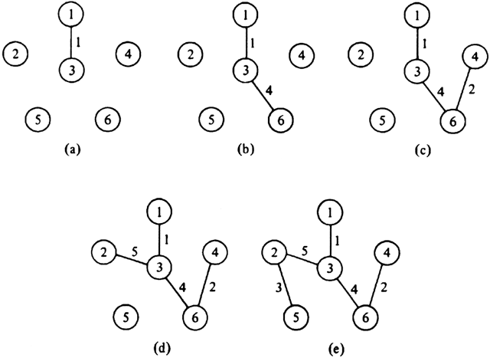
Vertex clusters
Need some way to identify which vertexes are "connected" to which other ones
we call these "clusters" of vertices
Also need an efficient way to figure out which cluster a given vertex is in.
Also need to merge clusters when adding an edge.

Slide 38
Today’s Route
Monday
WOW!
Kruskal
MST
Spanning Tree

Slide 39
Today’s Route
Monday
WOW!
Kruskal
MST
Spanning Tree

Slide 40
These are spanning trees!
…well homeomorphically irreducible trees

Slide 41
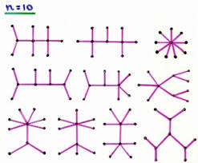

Slide 42
Did you know Chris is awesome?

Slide 43

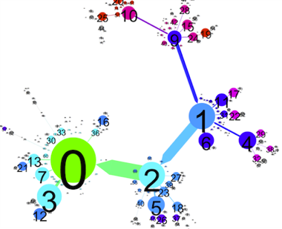
Autonomously Generating Hints by Inferring Problem Solving Policies

Slide 44
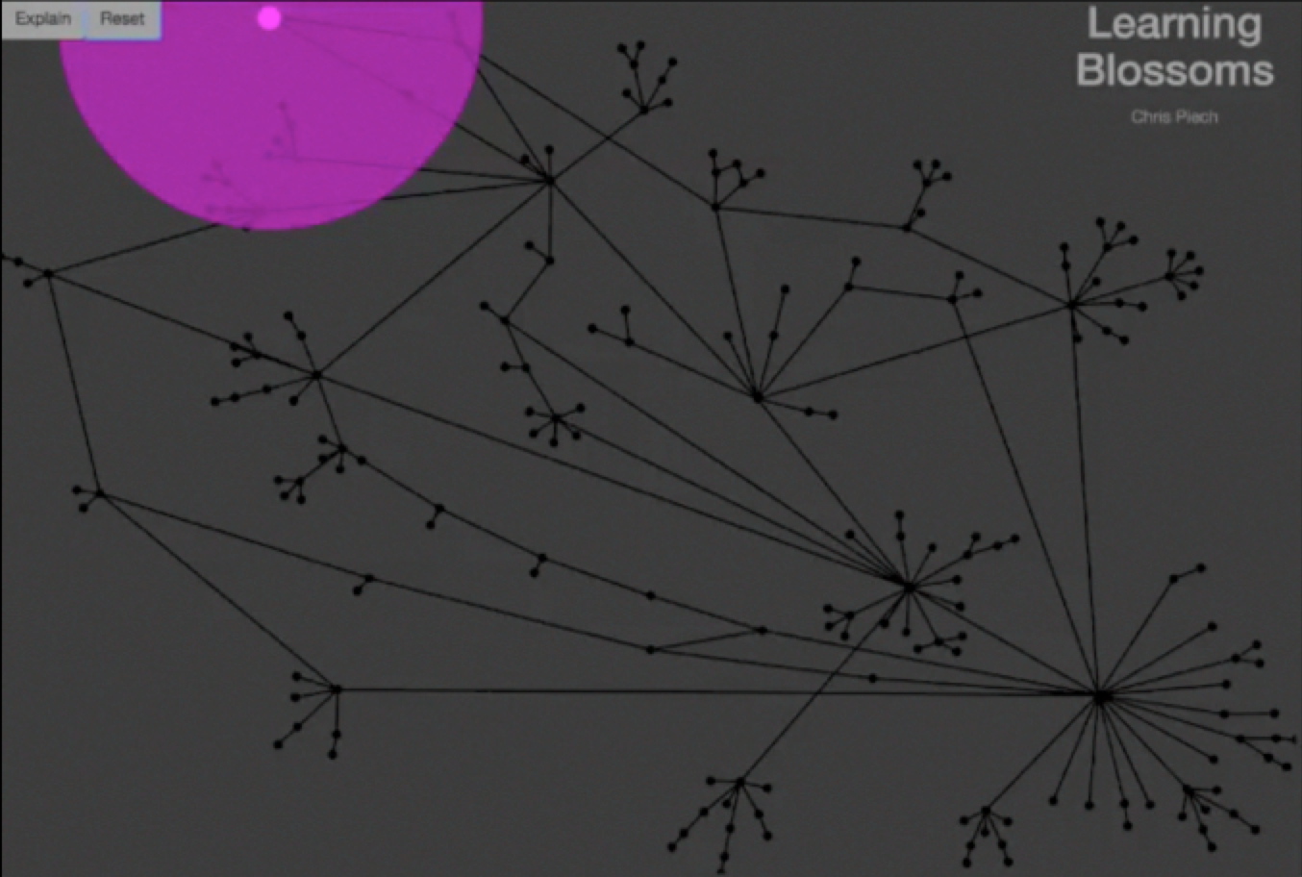

Slide 45
Each edge is what a teacher suggested
Pink dots are students.
Each node is a unique partial solution
Solution

Slide 46
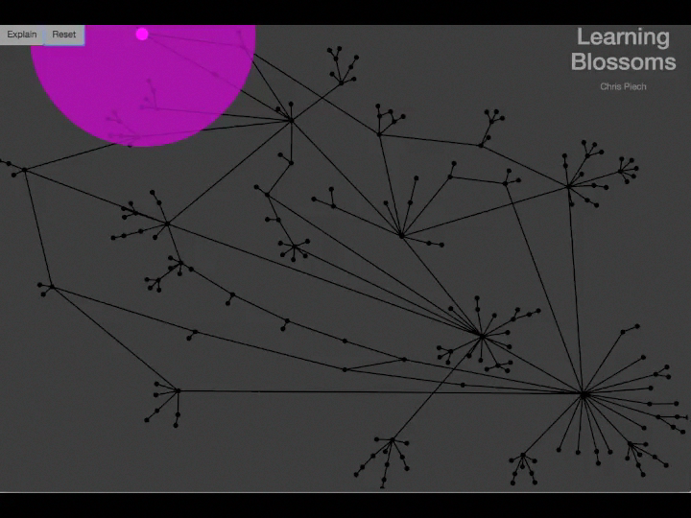

Slide 47
Machine Learning Problem
solution
Unique submissions

Slide 48
Problem Solving Policy
Machine Learning Problem
solution
Teacher “Policy”

Slide 49
Example Student
solution
Student 1

Slide 50
Example Student
solution
Student 2

Slide 51
Example Student
solution
Student 1,203,403

Slide 52
Machine Learning Problem
solution
Teacher “Policy”

Slide 54

Better Understand Learners

